Slide 1
Creating Colors
Part 3: Cones, color, curves, and afterimages!

Slide 2
Let’s Review: The Nature of Light
Sunlight contains colors of all wavelengths, from the longest (red), to orange, yellow, green, blue, indigo, and the shortest wavelength that you can see (violet)
Sunlight consists of a continuous range of colors, and not just those 7 colors

Slide 3
How Do Our Cone Cells See Color?
People often speak of red, green, and blue light, and red, green, and blue cone cells in our eyes
The way in which our retinas actually work is much more complicated than that!
If the next two slides seem too technical, just skip them for now, and proceed directly to the slides about afterimages, which are a very interesting effect created by our eyes and brain

Slide 4
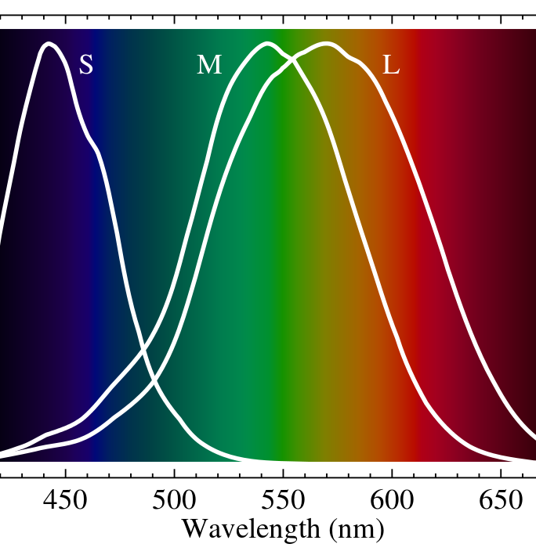
Cone Color Ranges
This chart shows how strongly each type of cone cell responds to light of any given color
S-cells (the S stands for Short wavelength) respond to a wide range of blue light
M-cells are most sensitive to medium wavelength green
L-cells respond much more strongly to long wavelength red than the other two types

Slide 5
Distinguishing Colors
Notice how much the three color ranges overlap?
Most colors trigger at least a small response from every kind of cone cell, but each cone cell type will respond differently to that color
Your brain notices the difference in signal levels from each kind of cone cell
This difference determines the color that you will see

Slide 6
Colorful Afterimages
On the next slide, there is a picture of the U.S. flag in colors that are very different from the usual red, white, and blue
Stare at the tiny black cross in the middle of the flag for about 15 to 30 seconds
Try not to look away, make sure you keep your eyes focused on the cross for the entire time
Now look at a light-colored background, like a wall or ceiling
What do you see?

Slide 7
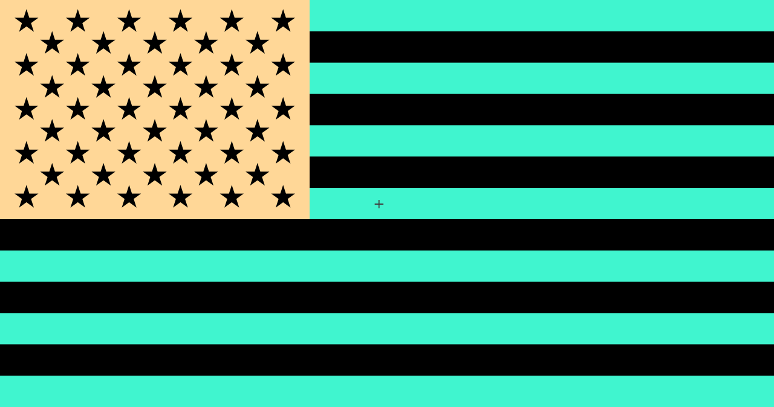

Slide 8
Did You See the Flag?
When you looked away after staring at the same part of the inverted color flag for a while, you saw a fuzzy image of the flag in its usual red, white, and blue colors
This effect is called an afterimage
Afterimages appear when your rods and cones are overstimulated and temporarily lose their sensitivity to light

Slide 9
What Happened Here?
When you stared at the blue-green (cyan) stripes, it overstimulated the blue and green cones in those sections of the image that was projected onto your retina
Those cones temporarily exhausted their supply of light-sensitive pigment, and your brain also decided to turn down the volume on the signals it had been receiving from those cones

Slide 10
Why Did You See the Afterimage?
When you looked away, your red cones were better equipped to get your brain to pay attention to their signals, so even though the light coming into your eyes wasn’t red, those areas of the afterimage looked red
In the same way, the yellow field behind the stars in the flag overstimulated your red and green cones, so you saw blue in that part of the afterimage
Cyan and red are complementary colors, just as yellow is the complementary color of blue

Slide 11
Design Your Own Afterimages
You can design your own afterimages by using a computer to invert the colors in a picture
To do this in Microsoft Paint, select the entire image, right-click on the image, and choose Invert color when the popup menu appears:
http://www.wikihow.com/Invert-Colours-in-MS-Paint
To do this using Apple Preview on a Mac:
http://www.macworld.com/article/1142027/previewinvert.html
This is how we created the image on the next slide!

Slide 13
Tips for Creating Afterimages
It’s difficult to avoid moving your eyes a little bit while you’re staring at the inverted image, which makes the afterimage a bit fuzzy and obscures all fine detail
This is why you’ll get the best results if you start with an image with large areas of the same color
Photographs of faces usually work well, so try this using a picture of someone you know, or perhaps a famous celebrity or historical figure

Slide 14
That’s all for Part 3, but we have more coming up in Part 4. If you enjoyed this workshop on colors, please let us know about it!
http://facebook.com/NHICC
http://www.instagram.com/nh_di
http://twitter.com/NH_DI

